Slide 1

Online News Popularity
Analysis
Group 6
Hiromi Bosman, Xiaoqun Wang, Zhaoning Su, Zili Ma, Congyang Wang

Slide 2
Outline
1. Project Introduction
2. Dataset Description
3. Methods Description
4. The Conclusion
1

Slide 3
Outline
1. Project Introduction
2. Dataset Description
3. Methods Description
4. The Conclusion
2

Slide 4
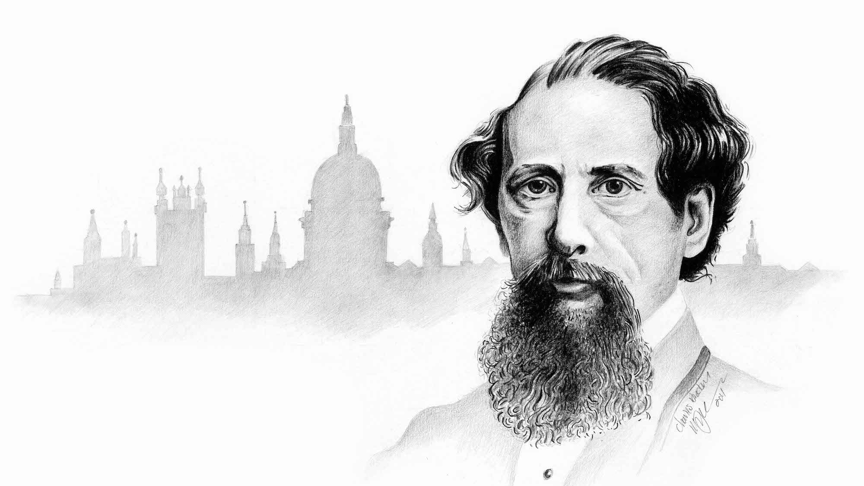
1. Project Introduction
Motivation
“
It was the best of times, it was the worst of times.
Charles Dickens
3
Notes:
ike the famous opening paragraph of Charles Dickens’ novel, A Tale of Two Cities said “It was the best of times, it was the worst of times.” Today is an information boom time, we met tons of news, photos, videos everywhere every second. For a media, how to write a meaningful and popular articles is a key thing to pursue, for a reader, to find a place where can read a meaningful article and willing to share to friends is a key thing to spend the time.

Slide 5

1. Project Introduction
Objective
Data Preprocessing
Modeling
Model Evaluation
Where
is
Dataset?
How
to
Deal with it?
What
is
Popularity?
What
Is
Our Objective
The Most Impact Features
Prediction Improvement
4
Notes:
And, we found this dataset, ‘Online News Popularity Dataset’ from famous UCI Machine Learning Repository. In this project, we will use the statistical method and process workflow to deal with, test and analysis the data to :
Popularity define:

Slide 6
Outline
1. Project Introduction
2. Dataset Description
3. Methods Description
4. The Conclusion
5

Slide 7
2. Dataset Description
About the Dataset
What is Mashable.com
Mashable (Mashable Inc.) is a digital media website founded by Pete Cashmore in 2005.
Data Set Characteristics: | Multivariate | Number of Instances: | 39797 | Area: | Business
Attribute Characteristics: | Integer, Real | Number of Attributes: | 61 | Date Donated | 2015-05-31
Associated Tasks: | Classification, Regression | Missing Values? | N/A | Number of Web Hits: | 70473
6

Slide 8
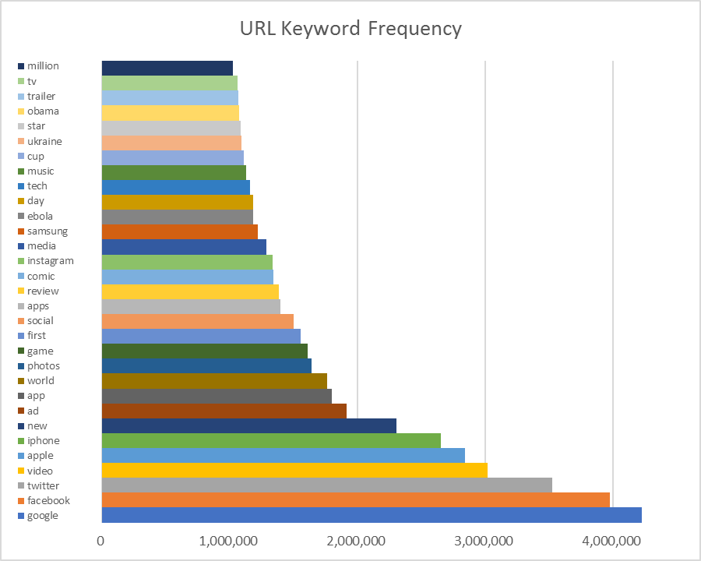
2. Dataset Description
One Result
amazon*593
instant*593
App*1500
URL | Shares
http://mashable.com/2013/01/07/amazon-instant-video-browser/ | 593
http://mashable.com/2013/01/07/ap-samsung-sponsored-tweets/ | 711
http://mashable.com/2013/01/07/apple-40-billion-app-downloads/ | 1500
… | ...
http://mashable.com/2013/01/07/att-u-verse-apps/ | 505
7
Notes:
How we can go deep, not from the url words, how about the …

Slide 9
Outline
1. Project Introduction
2. Dataset/feature Description
3. Methods Description
4. The Conclusion
8

Slide 10
3. Methods Description
Workflow of Analysis
Basic
Data Analysis
Data
Pre-processing
Variable selection
Modeling
Cross Validation
9
Notes:
The distribution of the target value (Shares) in our news popularity data set is very uneven, many outliers can be found. As shown in the following figures, the maximum share number far beyond the median by several orders. Therefore we used the median value as the criteria to dividing results into 2 classes popular articles and non-popular articles to avoid predicting the share numbers.

Slide 11
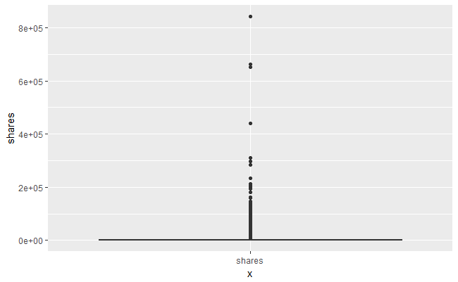
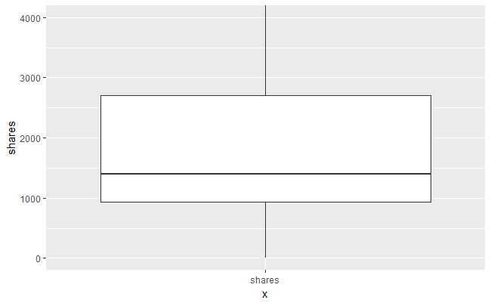
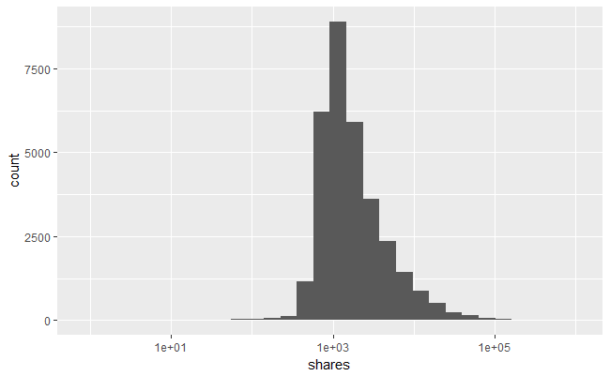



3. Methods Description
Basic Data Analysis
Target Analysis
OUTLIERS!!
Regression
Classification
10
Notes:
The distribution of the target value (Shares) in our news popularity data set is very uneven, many outliers can be found. As shown in the following figures, the maximum share number far beyond the median by several orders. Therefore we used the median value as the criteria to dividing results into 2 classes popular articles and non-popular articles to avoid predicting the share numbers.

Slide 12
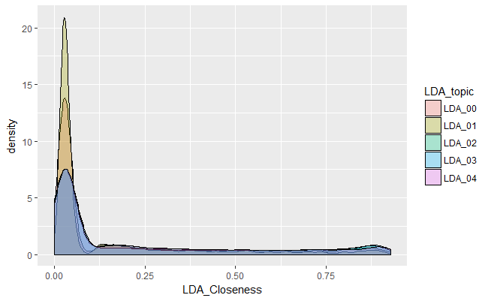
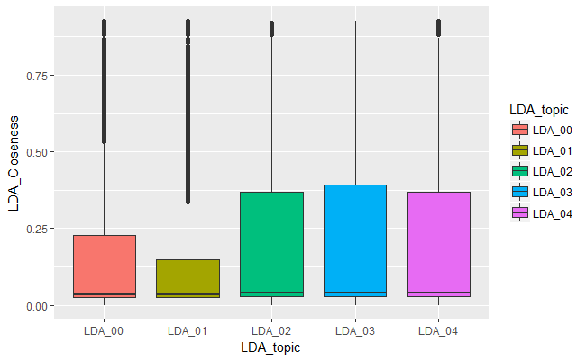

3. Methods Description
Basic Data Analysis
Feature Analysis (1/2)
OUTLIERS Again!!
One-peak Distribution
(Very looooong tail)
Many outliers
Variables: LDA-Topic-Related Terms
Outliers exist widely in features related to LDA-topic closeness.
Distribution patterns show the large variances in these variables.
11
Notes:
The outlier problems are serious in the original data set.
The 1st example comes from the LDA-topic-related features which are used to describe how close the posted article’s topic is to a specific LDA topic. From both the boxplot and density curve plot, the outlier observations are very common in LDA_00 and LDA_01. We cannot deal with these observation by simple removement.

Slide 13
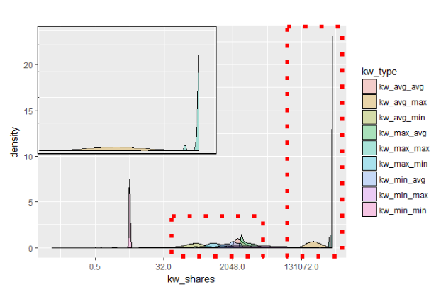
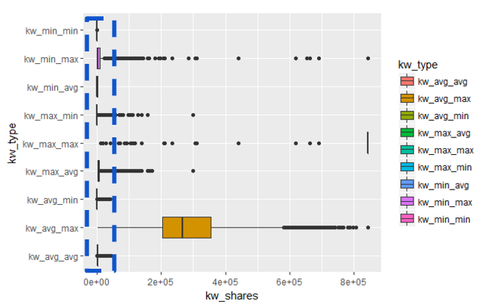
3. Methods Description
Basic Data Analysis
Feature Analysis (2/2)
OUTLIERS Again!!
Various Distribution
Many Outliers
Variables: Keyword-Related Terms
Outliers exist widely in features related to keywords.
Distribution patterns show the large variances in these variables.
12
Notes:
The 2nd example of outliers comes from the keyword-related features.These features are used to describe the maximum, minimum and average shares numbers of best, worst and average keywords. From the following figures, we can the main distribution peaks of these feature are usually located in the extreme value part (the extreme distribution patterns are more obvious in the boxplot.) Still, we can see many outliers existing in this features.

Slide 14
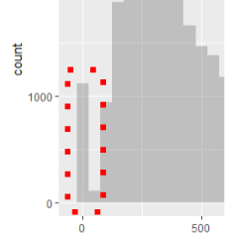
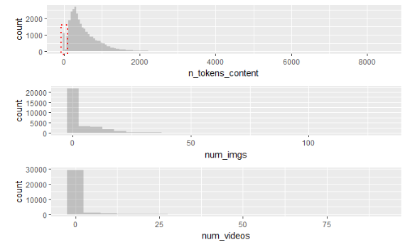
3. Methods Description
Basic Data Analysis
Unreasonable values
“
There are more than 1000 pieces of posted news in our data set without a single word.
13
Notes:
We also observed some feature which doesn’t make sense in the prediction process. The following figure shows three features’ distribution.“N_token_content” is used to take account for the number of words in the posted news. “num_imgst” is used to take account for the number of images in the posted news.“num_videos” is used to take account for the number of videos in the posted news.
It is reasonable for a online article without any image and video. However, it is very surprised that there are more than 1000 pieces of news without a single word. (The right figure is the zoomed-in version of the upper left figure)

Slide 15
3. Methods Description
Data Preprocessing
Conditions | Processing
Features with rare outliers | Remove the observations with the outlier value
Features with many outliers | Log Transformation
Features where most values are constant | Remove the feature
Feature values are unreasonable | Remove the observation
14
Notes:
In this part, We cleaned and transformed our data in the following way:

Slide 16
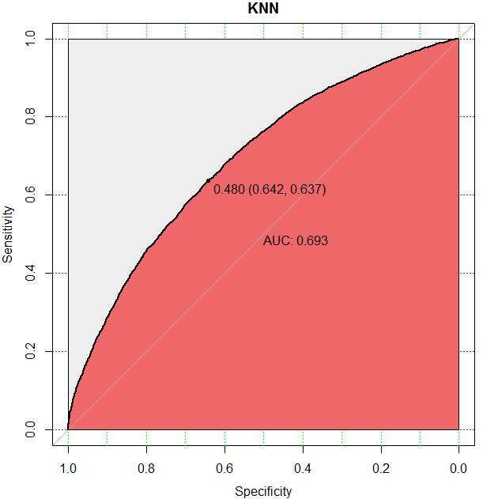
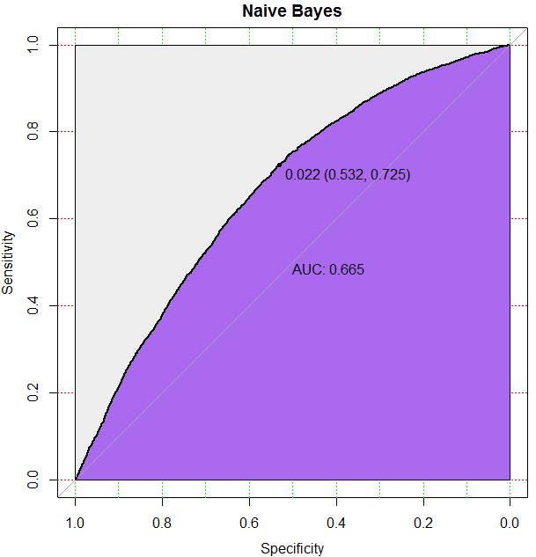
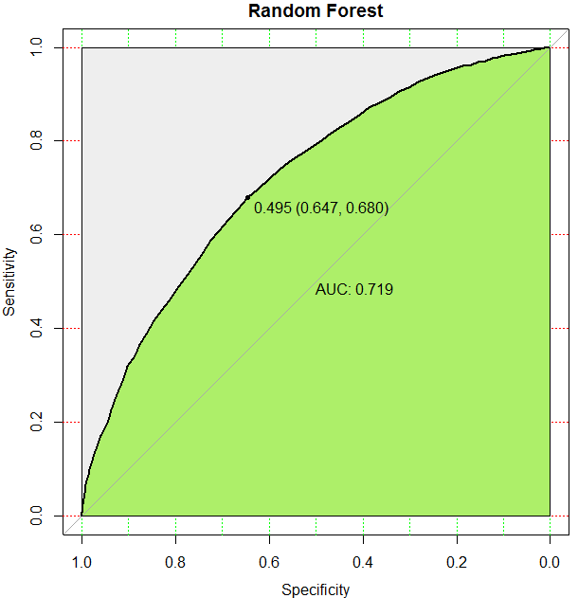
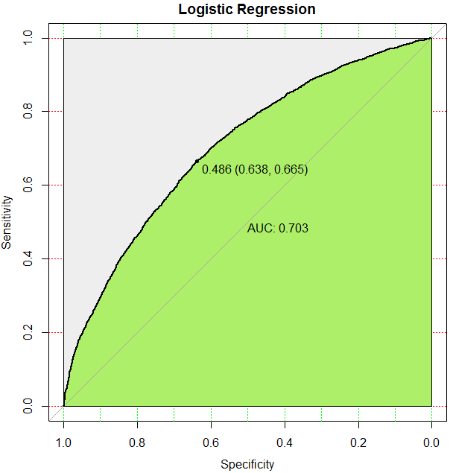
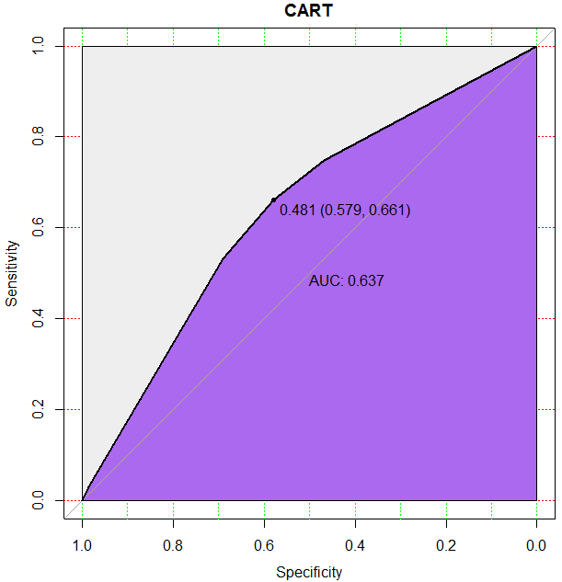

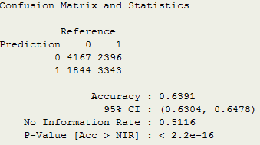
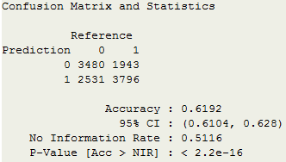
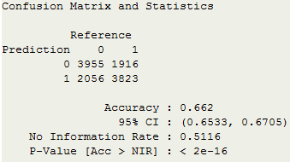
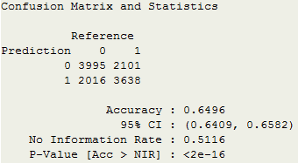
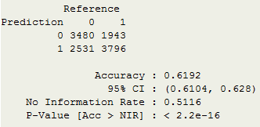
3. Methods Description
Classification Comparison
Modelling method | KNN | Naive Bayes | Random Forest | Logistic Regression | CART
ROC
CM
AUC: 69.3%
AUC: 66.5%
AUC: 71.9%
AUC: 70.3%
AUC: 63.7%
Accuracy: 63.9%
Accuracy : 61.9%
Accuracy : 66.2%
Accuracy : 64.9%
Accuracy : 61.9%
15
Notes:
Here we carried out 5 different classification methods including KNN, Naïve Bayes, Random forest, logistic regression and CART. The results given in formats of ROC and CM are shown below. In general, all methods have accuracy that is larger than 60%. In terms of accuracy, the best result is given by random forest with the highest accuracy equaling to 66.2%. CART and Naïve Bayes gave us the same lowest accuracy rate equaling to 61.92%

Slide 17
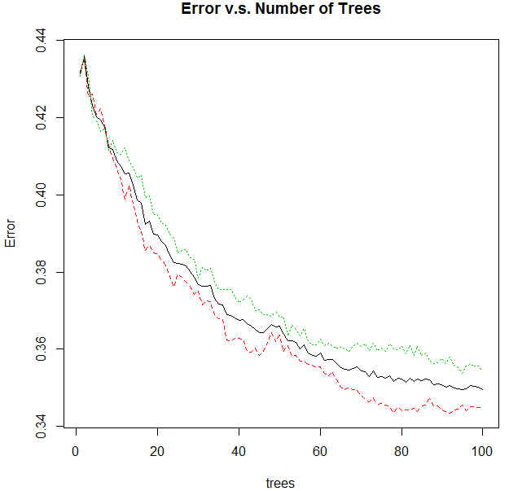
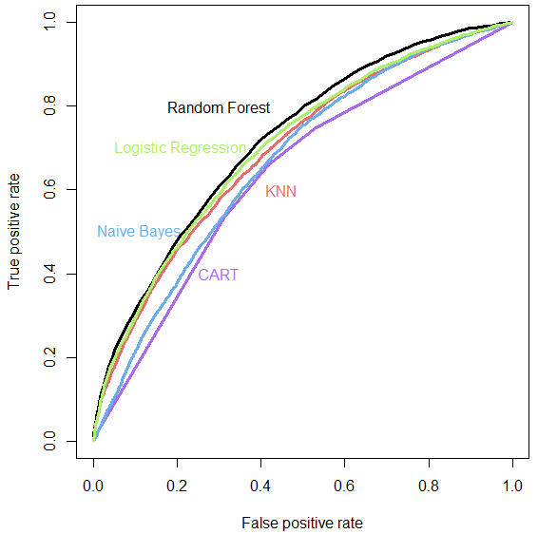
3. Methods Description
Classification Comparison
: Class 1
: Class 0
16
Notes:
The Combination of ROCs of different model in below right figure can show our cooperation result more clearly. AUC of KNN, Naïve Bayes, Random forest, logistic regression and CART are 0.693, 0.665, 0.719, 0.703, 0.607.

Slide 18
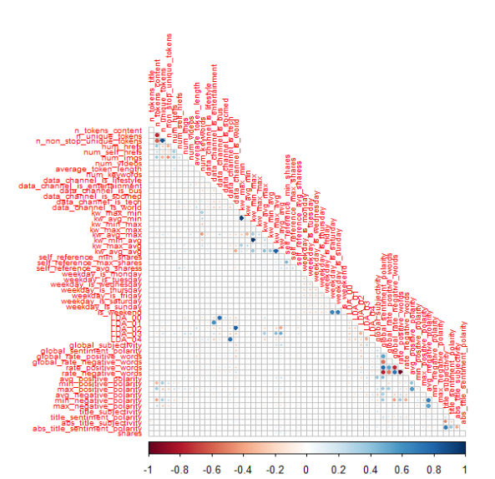
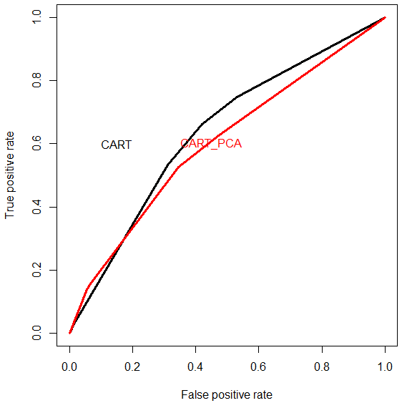
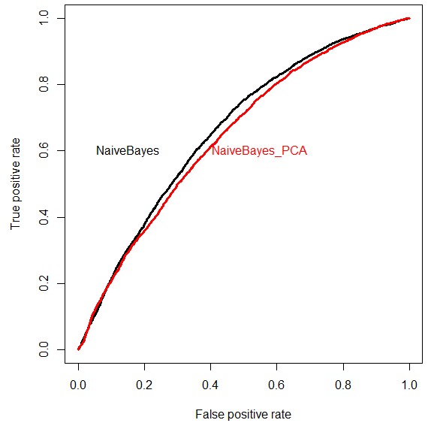
3. Methods Description
Dimension Reduction by PCA
17
Notes:
We tried to reduce the feature dimensions by PCA, the testing ROC results based on CART and Naive Bayes are shown as follows. The results indicate the PCA can reduce the feature number without losing too much accuracy, but in general, PCA cannot give us a better prediction by reducing the redundancy. The reason of the failure of PCA is the original feature set is well designed and the correlated between features is very limited. The correlation plot of the features is shown in the lower figure. We can see the appearance of highly correlated terms is rare and localized.

Slide 19
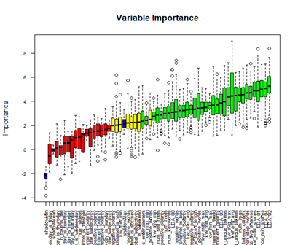
3. Methods Description
Feature Selection
By Boruta Library
: REJECTEFD
: TANTATIVE
: CONFIRMED
18
Notes:
Boruta library for R is a feature selection algorithm. Precisely, it works as a wrapper algorithm around Random Forest. This package derive its name from a demon in Slavic mythology who dwelled in pine forests. The following figures shows the comparison results between feature-selected modeling and non-feature-selected modeling. We first use Boruta to select the best features. Then model is built based on original data features and new selected features.
From the figures, we can see, the model built by Boruta selection gives us at least the same performance as the original ones provided. It is not surprised that Boruta has almost exactly same AUC as the AUC given by RF model, because Boruta is based on RF method too. The AUC result is shown in the following table.

Slide 20
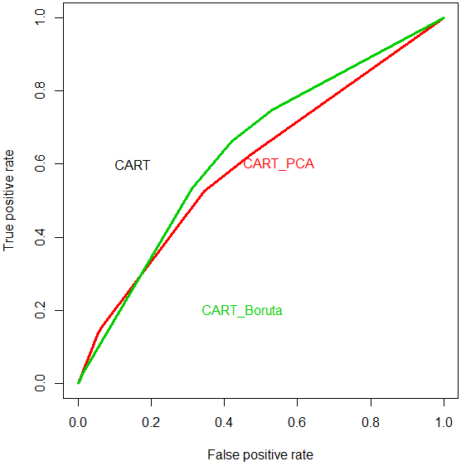
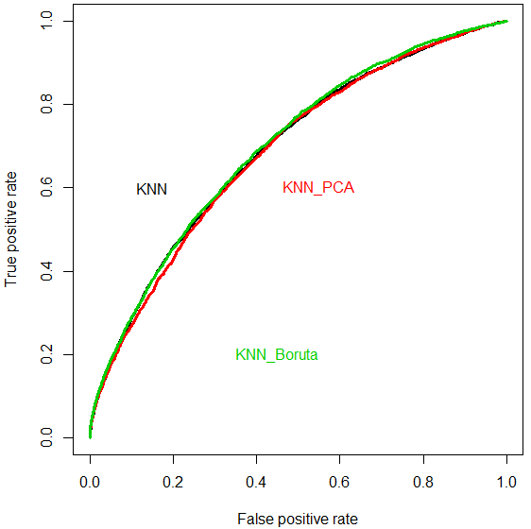
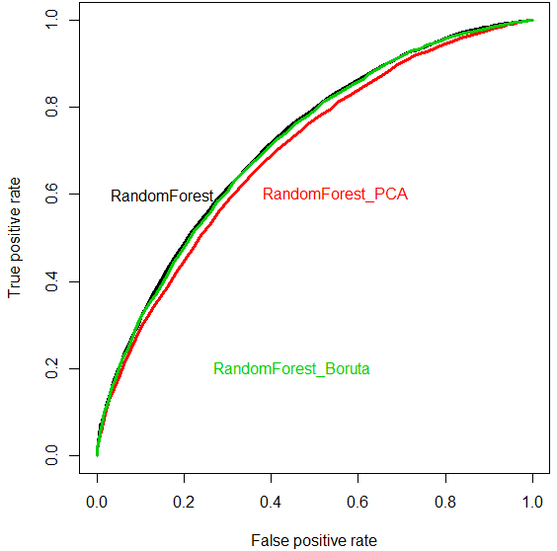
3. Methods Description
Feature Selection
Feature selection | AUC result of different Selection methods
Method | PCA | Boruta | Original
KNN | 0.6345 | 0.6413 | 0.6391
CART | 0.5918 | 0.6192 | 0.6192
NB | 0.5886 | 0.5952 | 0.5962
RF | 0.6435 | 0.6581 | 0.6579
LR | 0.6425 | 0.6484 | 0.6496
19
Notes:
Boruta library for R is a feature selection algorithm. Precisely, it works as a wrapper algorithm around Random Forest. This package derive its name from a demon in Slavic mythology who dwelled in pine forests. The following figures shows the comparison results between feature-selected modeling and non-feature-selected modeling. We first use Boruta to select the best features. Then model is built based on original data features and new selected features.
From the figures, we can see, the model built by Boruta selection gives us at least the same performance as the original ones provided. It is not surprised that Boruta has almost exactly same AUC as the AUC given by RF model, because Boruta is based on RF method too. The AUC result is shown in the following table.

Slide 21
Outline
1. Project Introduction
2. Dataset/feature Description
3. Methods Description
4. The Conclusion
20

Slide 22
4. The Conclusion
The Conclusion
KNN, Naive Bayes, Random Forest, Logistic Regression, CART
PCA, Boruta
Prediction
21
Notes:
The tree model based on classification tree and CART are shown as below. The key variables selected by the 2 models for splitting are different.
For the C-tree model, the key factors determining whether a piece of news is popular online selected by the model are positive and negative word-related features like “rate_negative words” and “rate_positive words”. While the key factors selected by CART trees are quite different. In this model, Average keyword’s average share number and the channel type of the news are considered as more important.
These various and low correlated tree model may explain why both of them cannot give us a good accuracy. However, the best option of the data set with the large variance in tree models is just RF model. Our result also agree with our idea that RF has the best performance on our data set.

Slide 23
THANK YOU
Group 6
Hiromi Bosman, Xiaoqun Wang, Zhaoning Su, Zili Ma, Congyang Wang

